Slide 1
Digital portfolio
Student Name : tanzila banu H N
Register no : 34624u09096 /
NM I’d : astvu346M24303
Department: BCA
College : mmes women’s arts and science
College , thiruvalluvar university

Slide 2
Profile hub My digital portfolio

Slide 3
Agenda
Problem Statement
Project Overview
End Users
Tools & Technologies
Design & Layout
Features
Results & Screenshots
Conclusion
GitHub Link

Slide 4
Problem statement
Normal resumes are plain and boring
Students don’t have a good way to show their skills
Recruiters cannot see real projects or creativity
Need a digital portfolio website to solve this problem

Slide 5
Project overview
ProfileHub is a student portfolio website
Built using HTML, CSS, and JavaScript
Has pages: Home | About Me | Projects | Contact
Works on both mobile and computer (responsive)
Published online using GitHub Pages

Slide 6
End users
Students → To show their skills and projects
Recruiters → To check student profiles easily
Teachers → To review student work online

Slide 7
Tools & technology
HTML → For website structure
CSS → For styling and design
JavaScript → For interactivity
GitHub → To save and publish the website

Slide 8
Design & layout
Home Page → Introduction and menu
About Me Page → Education and skills
Projects Page → List of projects
Contact Page → Form to send messages
Responsive Layout → Works on all devices

Slide 9
Features
Simple and user-friendly website
Smooth navigation between pages
Basic animations and effects
Contact form with validation
Projects shown in gallery format
Works on both mobile and computer

Slide 10
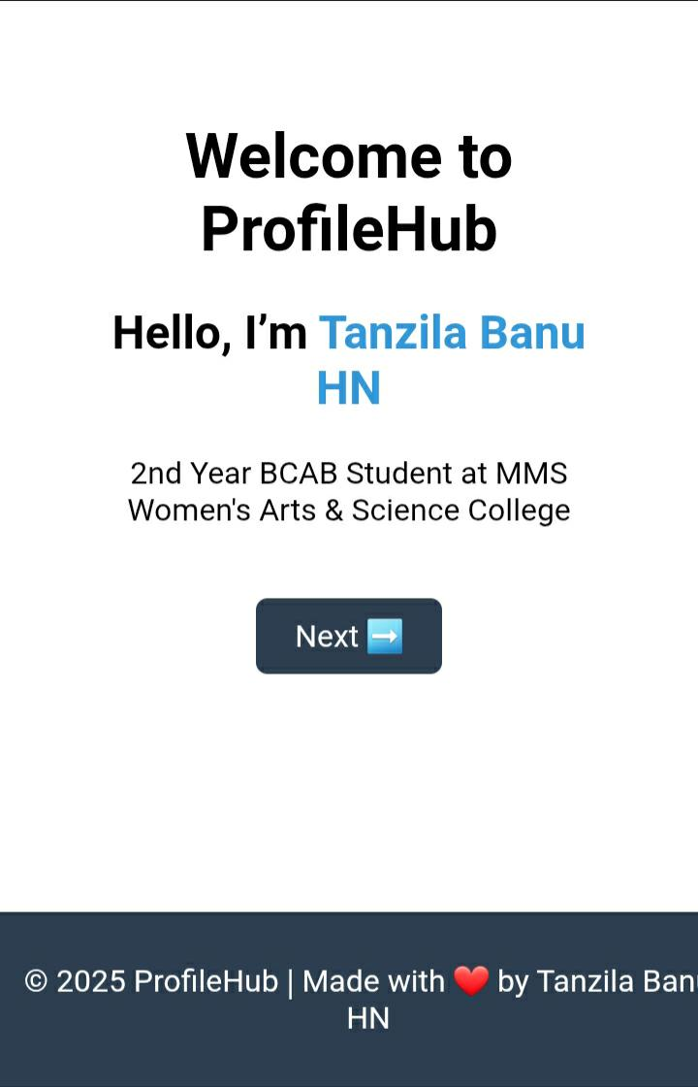
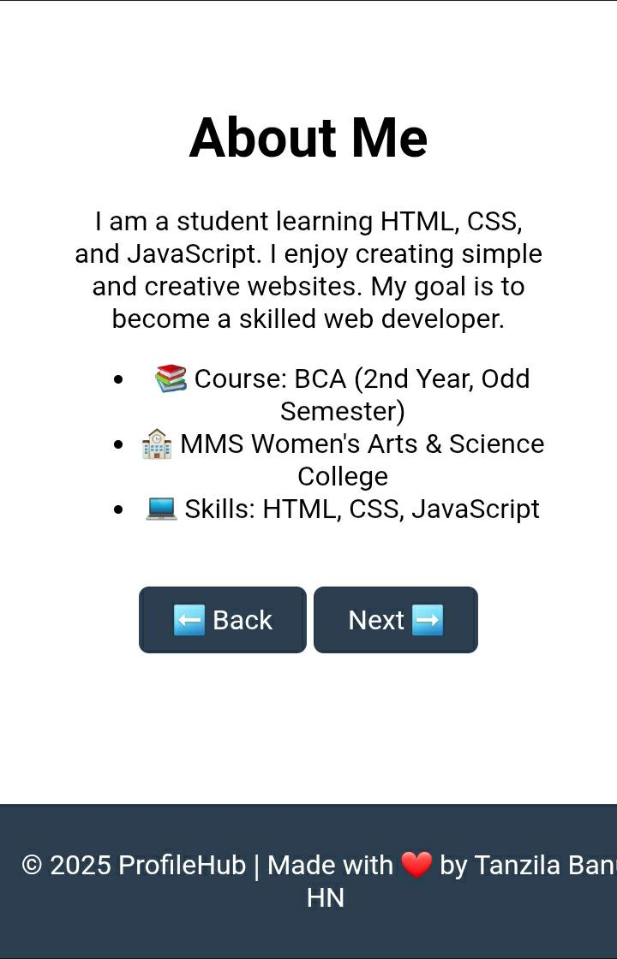
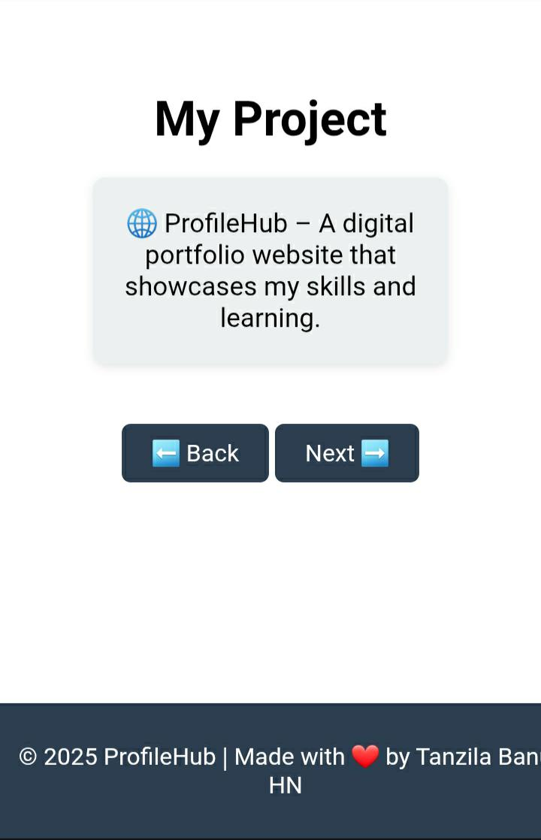
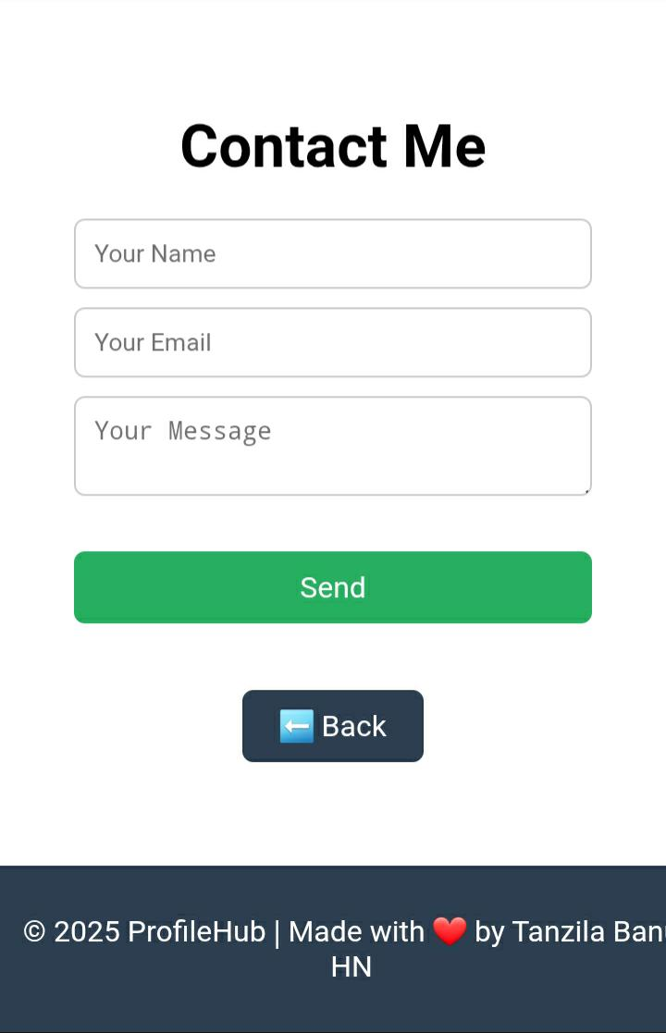
Screen shot & result

Slide 11
Conclusion
ProfileHub gives students a digital identity
Helps in jobs, placements, and internships
Shows skills in web development
Better than a normal resume

Slide 12
Git hub link
https://tanzilabanuhn-star.github.io/Profilehub/
THANK YOU ........♡

